Slide 1
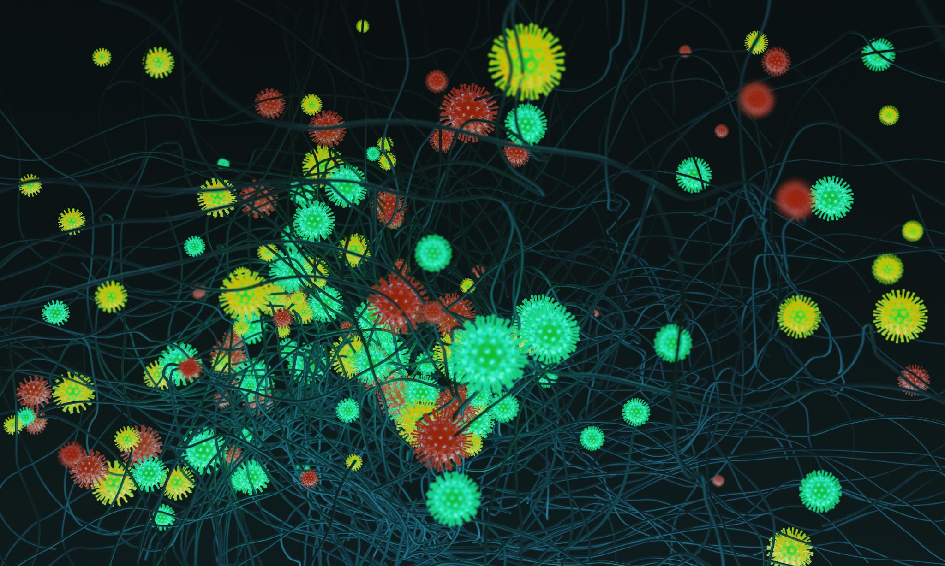

SARS-CoV-2 scRNA-seq Pseudotime Trajectory Analysis
A single-cell trajectory analysis of the human airway epithelium reveals a dual-marker model of viral progression.
Notes:
Image source: Microsoft 365 content library Trajectory analysis in Scanpy enables the study of cellular development and differentiation paths using single-cell RNA-seq data. Visual tools like pseudotime plots and UMAP projections help illustrate dynamic cellular changes. These visualisations reveal progression and branching events, aiding in the understanding of complex biological processes.

Slide 2











How can we map the cellular-level impact of SARS-CoV-2 over time?
Human Bronchial Epithelial Cells
Key Experimental Details
System: Human Bronchial Epithelial Cells (HBECs)
Timepoints: Mock (uninfected control), 1 Day Post-Infection (1dpi), 2 dpi, and 3 dpi.
Objective: To build a dynamic, high-resolution map of the transcriptional changes that occur as the infection takes hold.
Infection
Mock
1 dpi
2 dpi
3 dpi
Reference: Ravindra et al., “Single-cell longitudinal analysis of SARS-CoV-2 infection in human bronchial epithelial cells,” PLOS Biology (2021). https://journals.plos.org/plosbiology/article?id=10.1371/journal.pbio.3001143
Single-Cell RNA Sequencing (scRNA-seq)

Slide 3

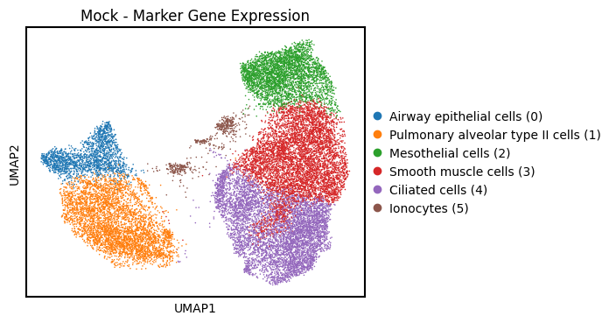

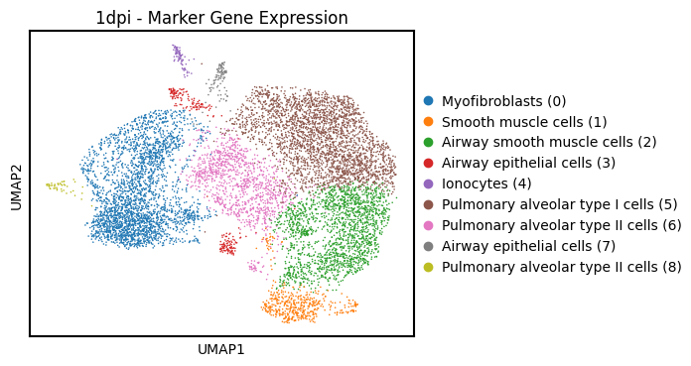

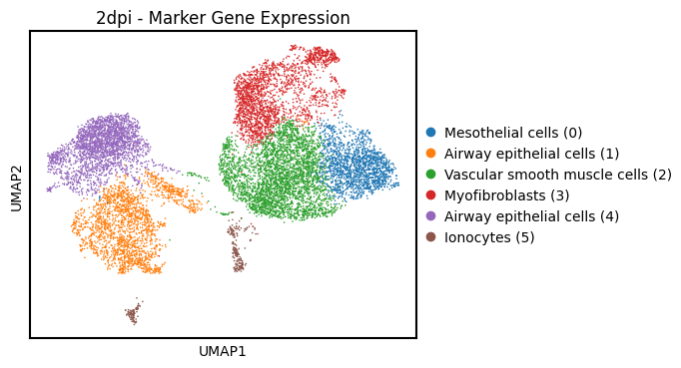

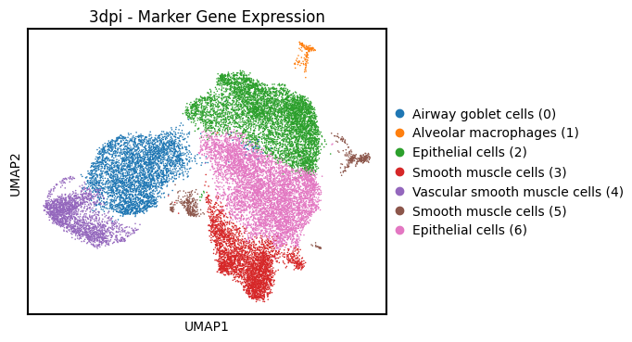
The airway epithelium at baseline is a complex and structured community.
Below the images show the cell type composition at different stages of infection.

Slide 4
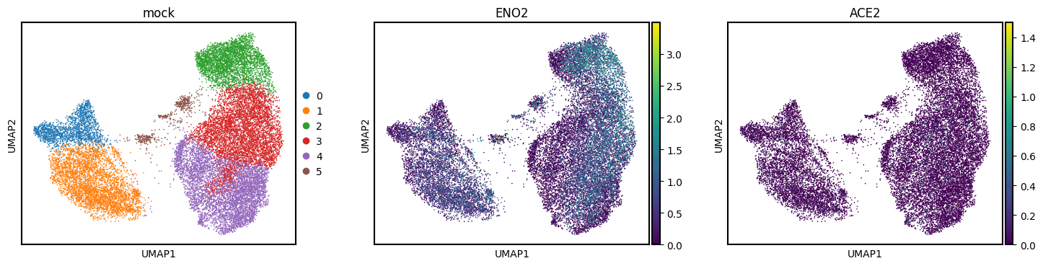
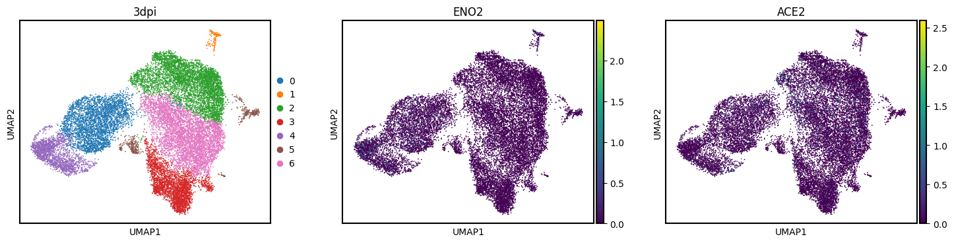
ENO2 vs ACE2
ACE2 serves as a spatial marker of viral entry, while ENO2 captures the systemic metabolic stress accompanying viral replication, together illustrating the cellular choreography of COVID-19 infection.

Slide 5
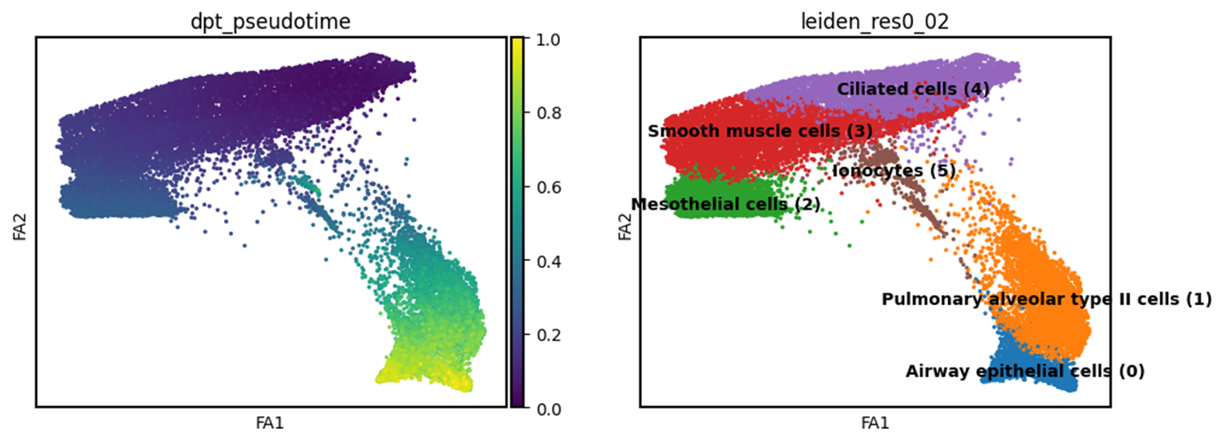
Pseudotime Trajectory Analysis
Mock (0dpi)
The pseudotime trajectory of uninfected cells shows the normal differentiation of airway epithelia.
Early pseudotime includes airway epithelial cells, while alveolar, ciliated, and ionocyte cells appear later, reflecting maturation.
Smooth muscle and mesothelial clusters remain distinct, matching their non-epithelial nature.
This healthy baseline provides a reference for assessing changes caused by infection.
Figure 4. Pseudotime and cell type distribution at mock (uninfected cells).

Slide 6
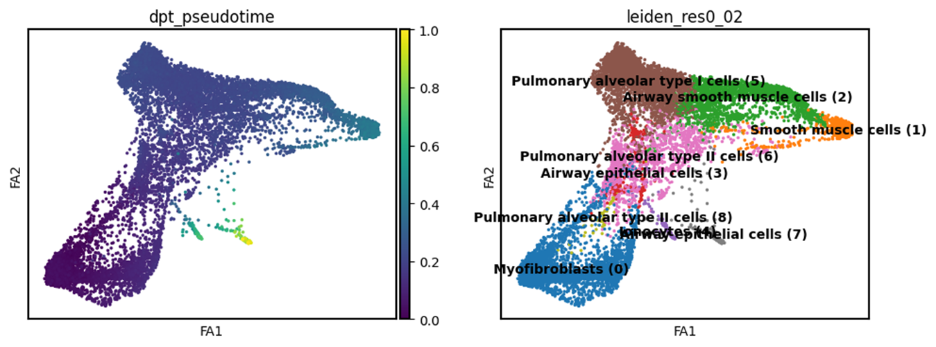
Pseudotime Trajectory Analysis
The 1 dpi trajectory shows the first detectable shift from baseline epithelial homeostasis toward infection-associated states.
The presence of alveolar and ionocyte cells in later pseudotime suggests that viral sensing and metabolic adaptation begin as early as 24 hours post-infection, but global transcriptional remodeling is still incomplete.
Figure 5. Pseudotime trajectory and cell type clustering at 1 dpi.
Cells progress from airway epithelial and myofibroblast populations (early pseudotime, purple) to pulmonary alveolar and ionocyte clusters (late pseudotime, yellow), indicating early infection-associated transcriptional activation. Branching of the pseudotime manifold suggests heterogeneity in the host response, where some epithelial cells remain homeostatic while others initiate metabolic and antiviral programs.

Slide 7
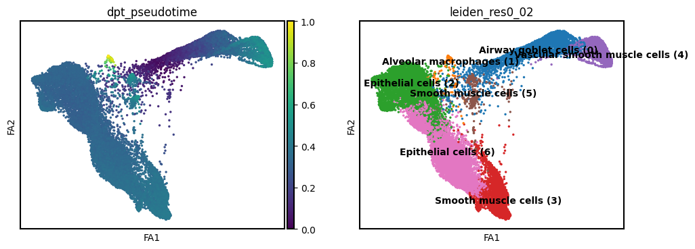
Pseudotime Trajectory Analysis
Figure 6. Pseudotime and cell type distribution at 3 dpi reveal advanced transcriptional remodeling during SARS-CoV-2 infection.
By 3 dpi, SARS-CoV-2 infection induces profound transcriptional remodeling, shifting the cellular system from stable epithelial homeostasis toward a highly inflammatory and immune-dominated state.
Pseudotime reflects infection progression and tissue response rather than differentiation, with macrophages and goblet cells representing terminal response states.

Slide 8
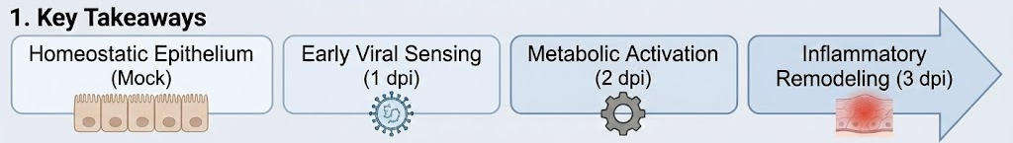
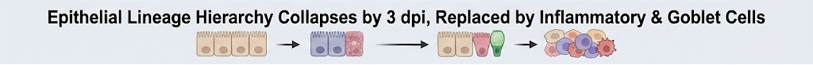
CONCLUSION
SARS-CoV-2 infection is not a single event; it is a dynamic reprogramming of the airway epithelium. Through pseudotime, we capture the molecular choreography of viral entry, metabolic adaptation, and tissue inflammation.
Notes:
Image source: Microsoft 365 content library Pseudotime analysis reveals how individual cells progress during SARS-CoV-2 infection, highlighting dynamic changes in gene expression. This approach uncovers cellular pathways affected at different infection stages. Understanding these dynamics aids in identifying targets for therapeutic intervention and deepens insight into the host response to SARS-CoV-2.

